Slide 1

ECE 2031 SRAM Demonstration
Team 101-- Sarah Copenhaver, Michael Probst, Maya Rajan, Caleb Song, Harsha Tambareni

Slide 2

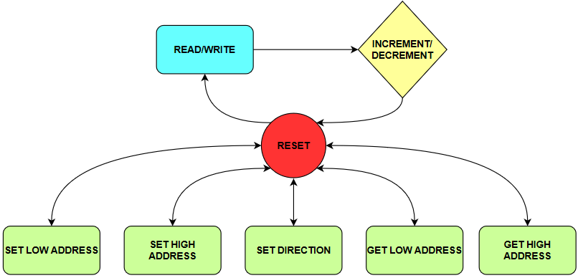
State Machine Overview

Slide 3
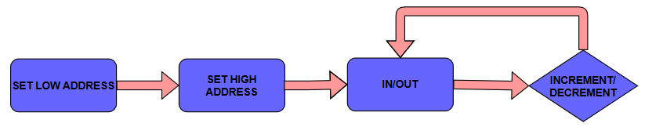
How to Read and Write
Address must only be set once and then iterates automatically
User has capability to change whether address increments, decrements, or stays the same
Only one instruction required to read or write

Slide 4
SIMULATIONS

Slide 5
Future Work
Implement function to reset all the memory
Search memory for a particular value and return its memory address
Reduce the number of states for read or write
Conclusion
State machine design provided easy way to meet timing requirements
Disorganization made us miss that we were using an extra signal that was taking time

